Slide 1
The subtle edge of migration: a rocky shore
Neil Haddon

Slide 2
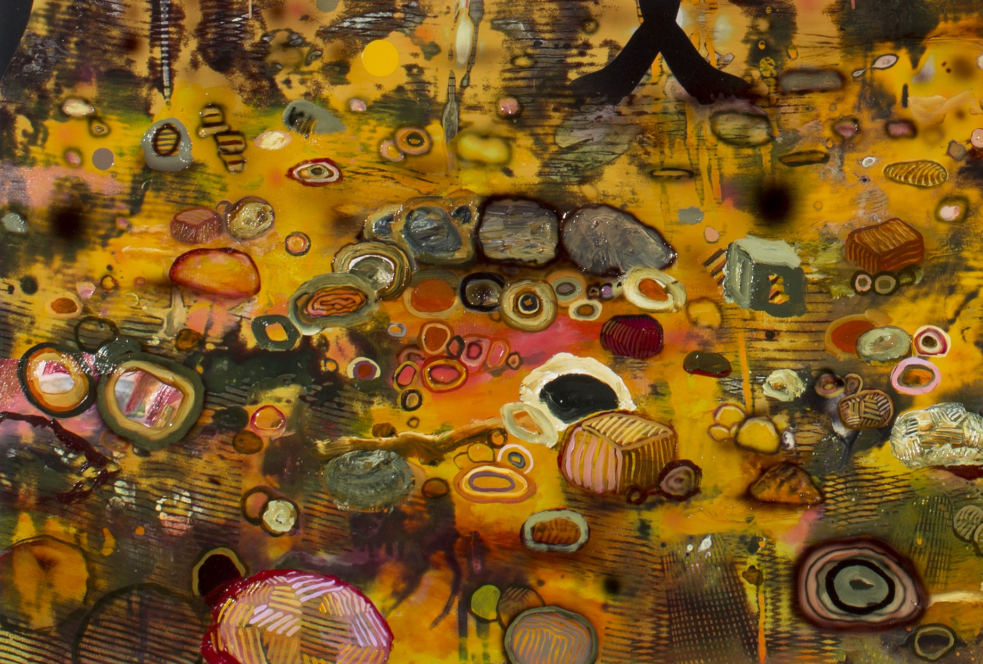
Haddon, N. 2018, A Rocky Shore
enamel, oil, vinyl, marker pen and digital print on aluminium,
130 cm x 122 cm
https://www.johnglover.com.au/about/2018-finalists
https://www.johnglover.com.au/exhibitions/archive/glover-prize-exhibition-2018
[accessed 30.10.18]

Slide 3
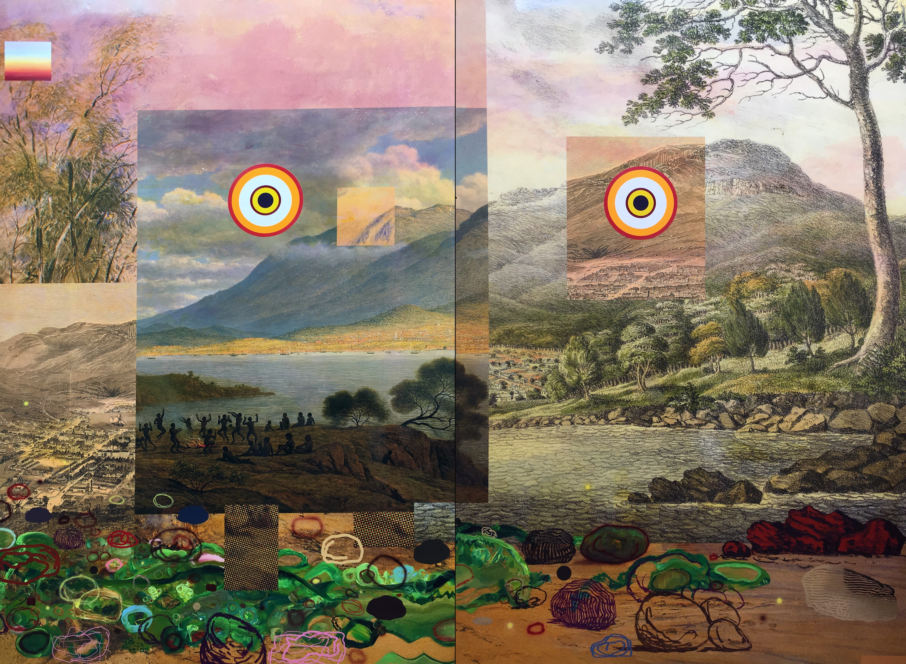
Haddon, N. 2018,
We’ll bring our own views
enamel, oil, vinyl, marker pen and digital print on aluminium panels
180 cm x 240 cm
https://tasmaniantimes.com/2018/07/please-join-us-for-the-opening-of-dear-kunanyi/
[accessed 30.10.18]

Slide 4
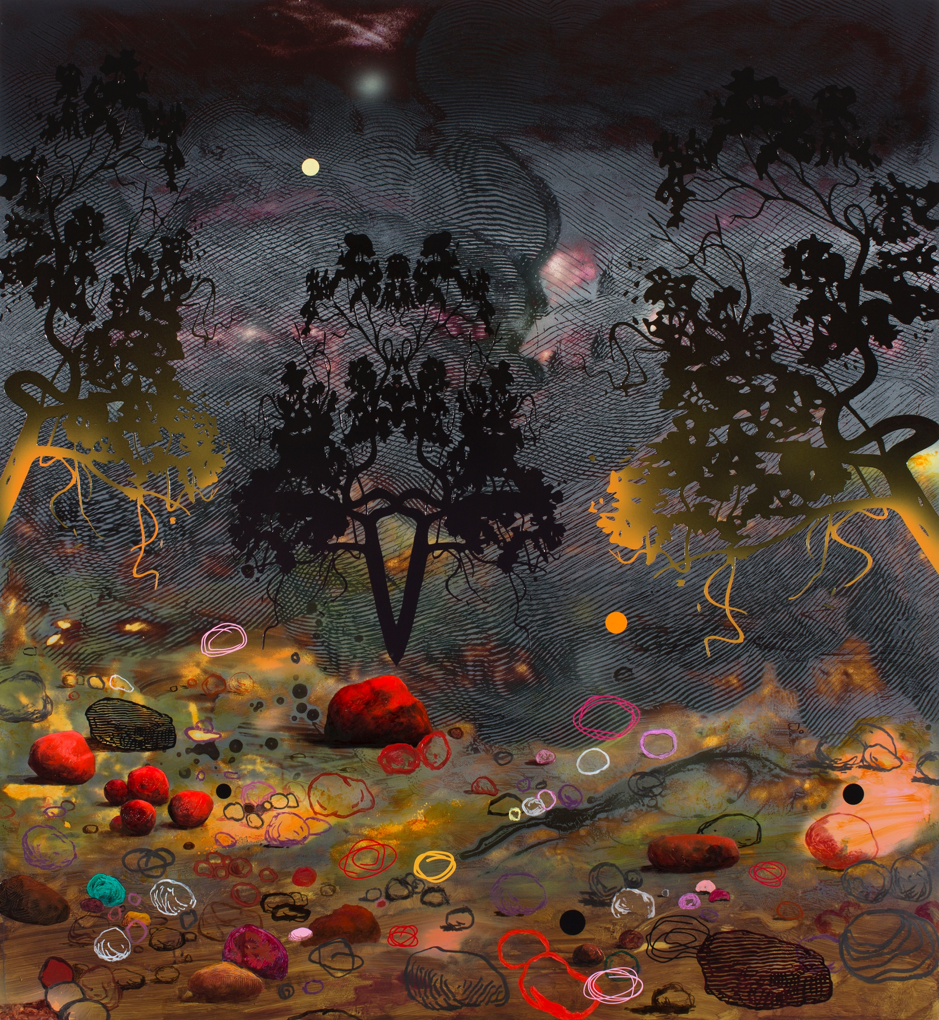
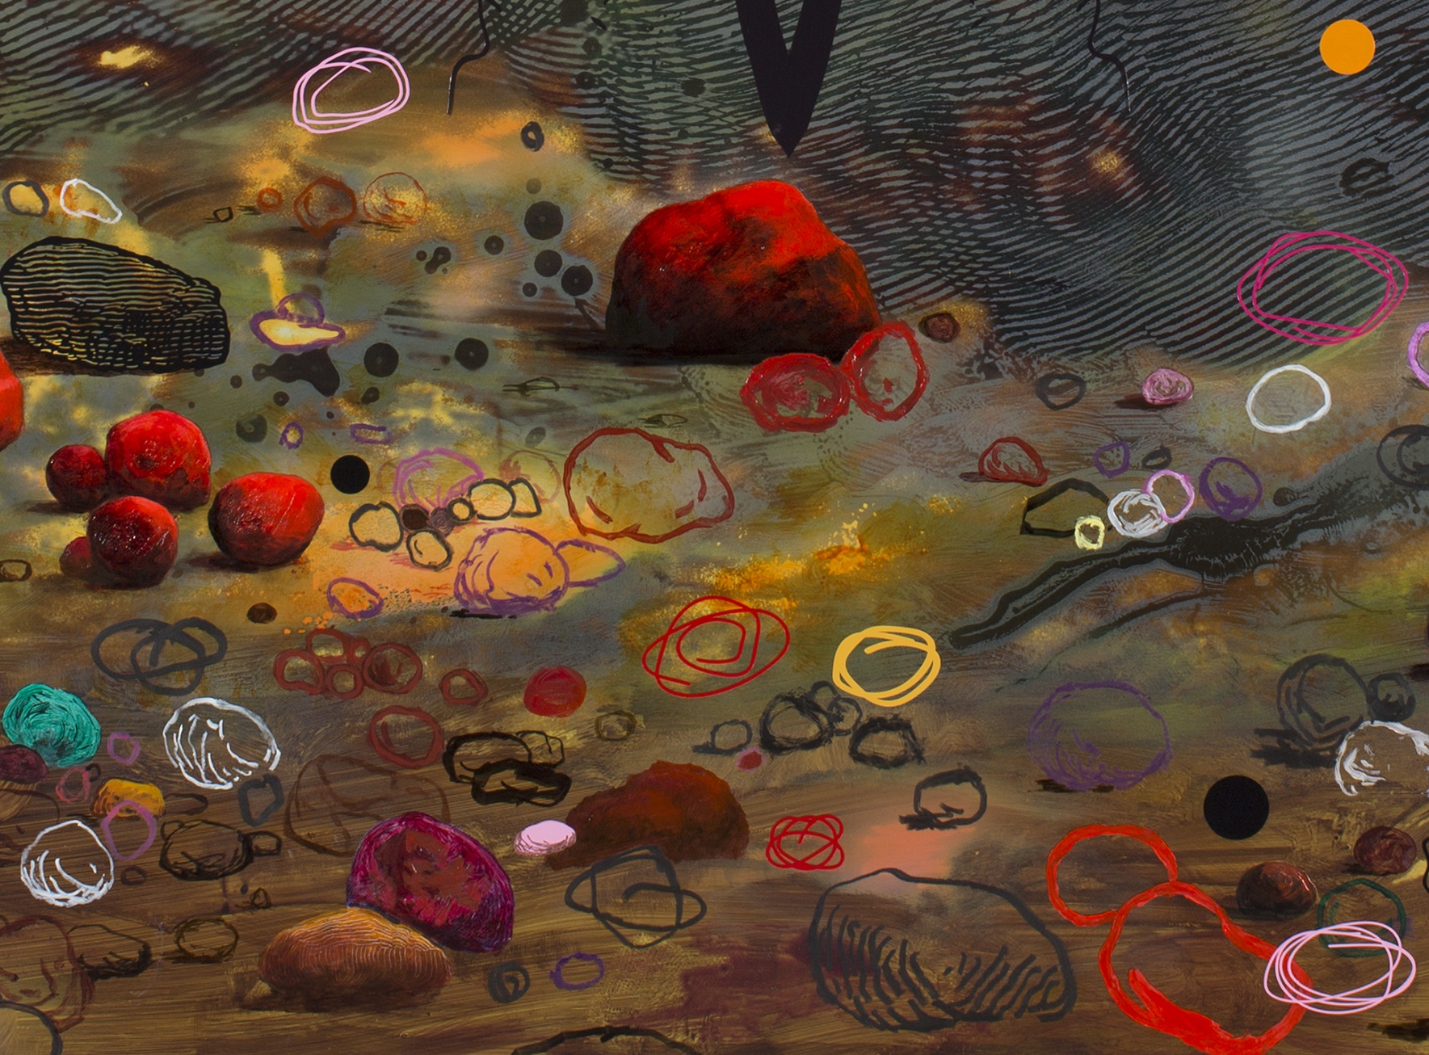
Haddon, N. 2018, Another Rocky Shore
enamel, oil, vinyl, marker pen and digital print on aluminium,
122 cm x 110 cm
https://www.devonportgallery.com/index02.php?id=12
[accessed 30.10.18]

